Slide 1


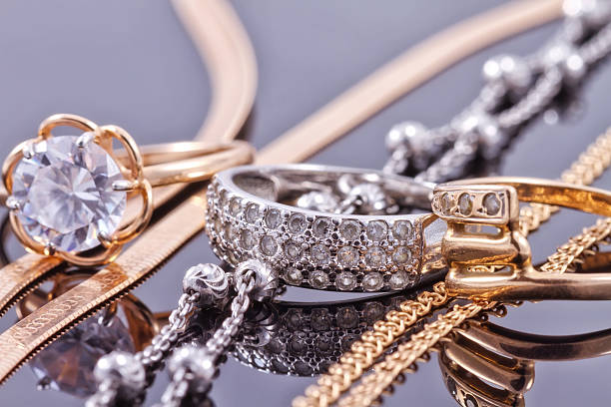
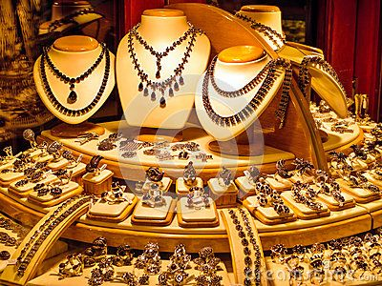
JEWELRY PRICE OPTIMIZATION
REPORT
Munikat Dirisu A.

Slide 2
INTRODUCTION
Gemineye is high-end jewellery brand known for its quality and innovation. With a global presence and a diverse customer base, the company has built a strong reputation for craftsmanship and exclusive designs.
However, setting the right prices for its jewellery remains a challenge.
Currently, the pricing decisions are made manually, which can be slow and may not always reflect the latest market trends or customer preferences. To stay competitive and maximize revenue, Gemineye needs a smarter, more data-driven approach to pricing.

Slide 3
METHODOLOGY
Business Understanding
Data Understanding
(EDA)
Data Preparation
(Feature Engineering)
Deployment/ Key Findings and Recommendation
Jewelry Data
Modeling
(Linear, ExtraTrees, XGBoost)
Evaluation
(r2, MAE, RMSE, MSE)
CRISP-DM

Slide 4



BUSINESS PROBLEM
The company struggles to set optimal prices that attract price-sensitive customers without sacrificing profit margins.
Manual pricing adjustments are inefficient and often inconsistent across regions and product lines.
Rapid changes in market trends, customer demand and competitive actions make it difficult to respond quickly.
A lack of predictive insights into demand and price elasticity restricts effective decision-making.

Slide 5
GOALS AND OBJECTIVES
Gain deeper insights into customer preferences and demand patterns to inform strategic decisions.
Enable the company to adjust prices dynamically in response to market conditions.
Automate the pricing process to reduce manual effort and improve consistency across regions.
Develop a machine learning-based pricing system that can recommend the best prices for jewelry products

Slide 6


OBSERVATIONS
WITH
THE
DATA

Slide 7
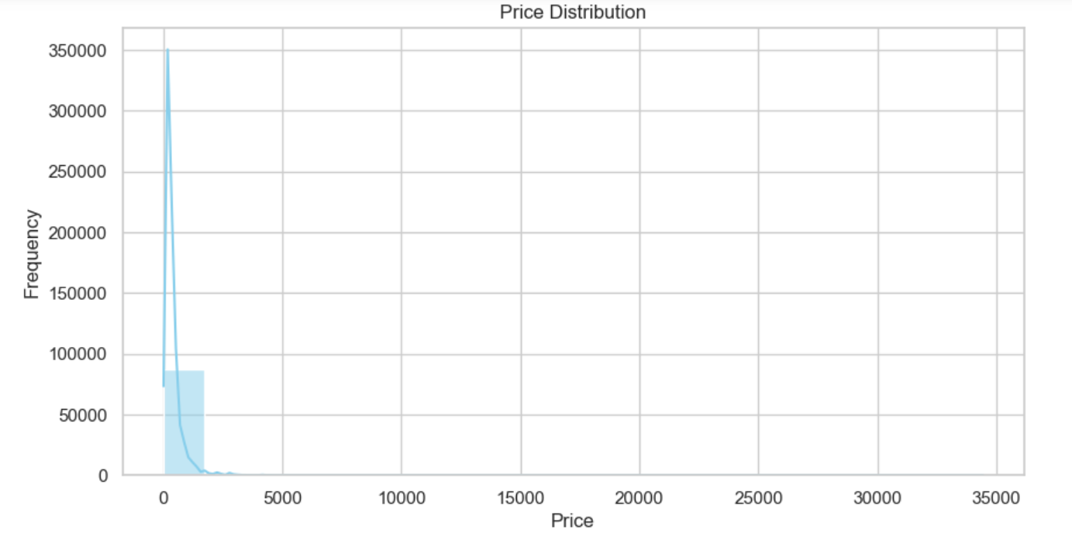
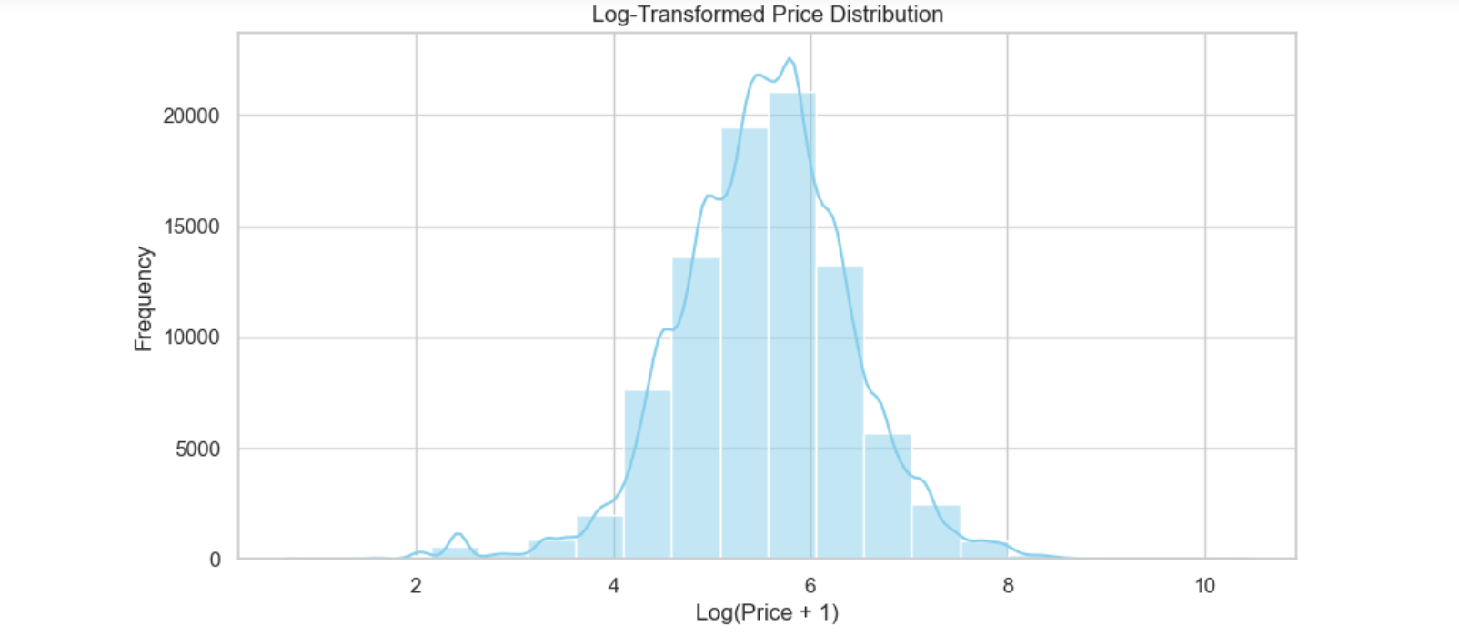
PRICE ANALYSIS
Most items are low-priced, with a few high-priced outliers pulling the average upward and creating a positive skew.
The log-transformed price distribution shows a clear improvement in symmetry, turning the originally skewed data into a more bell-shaped, normal-like curve. Most prices now cluster around the 250–400 range

Slide 8
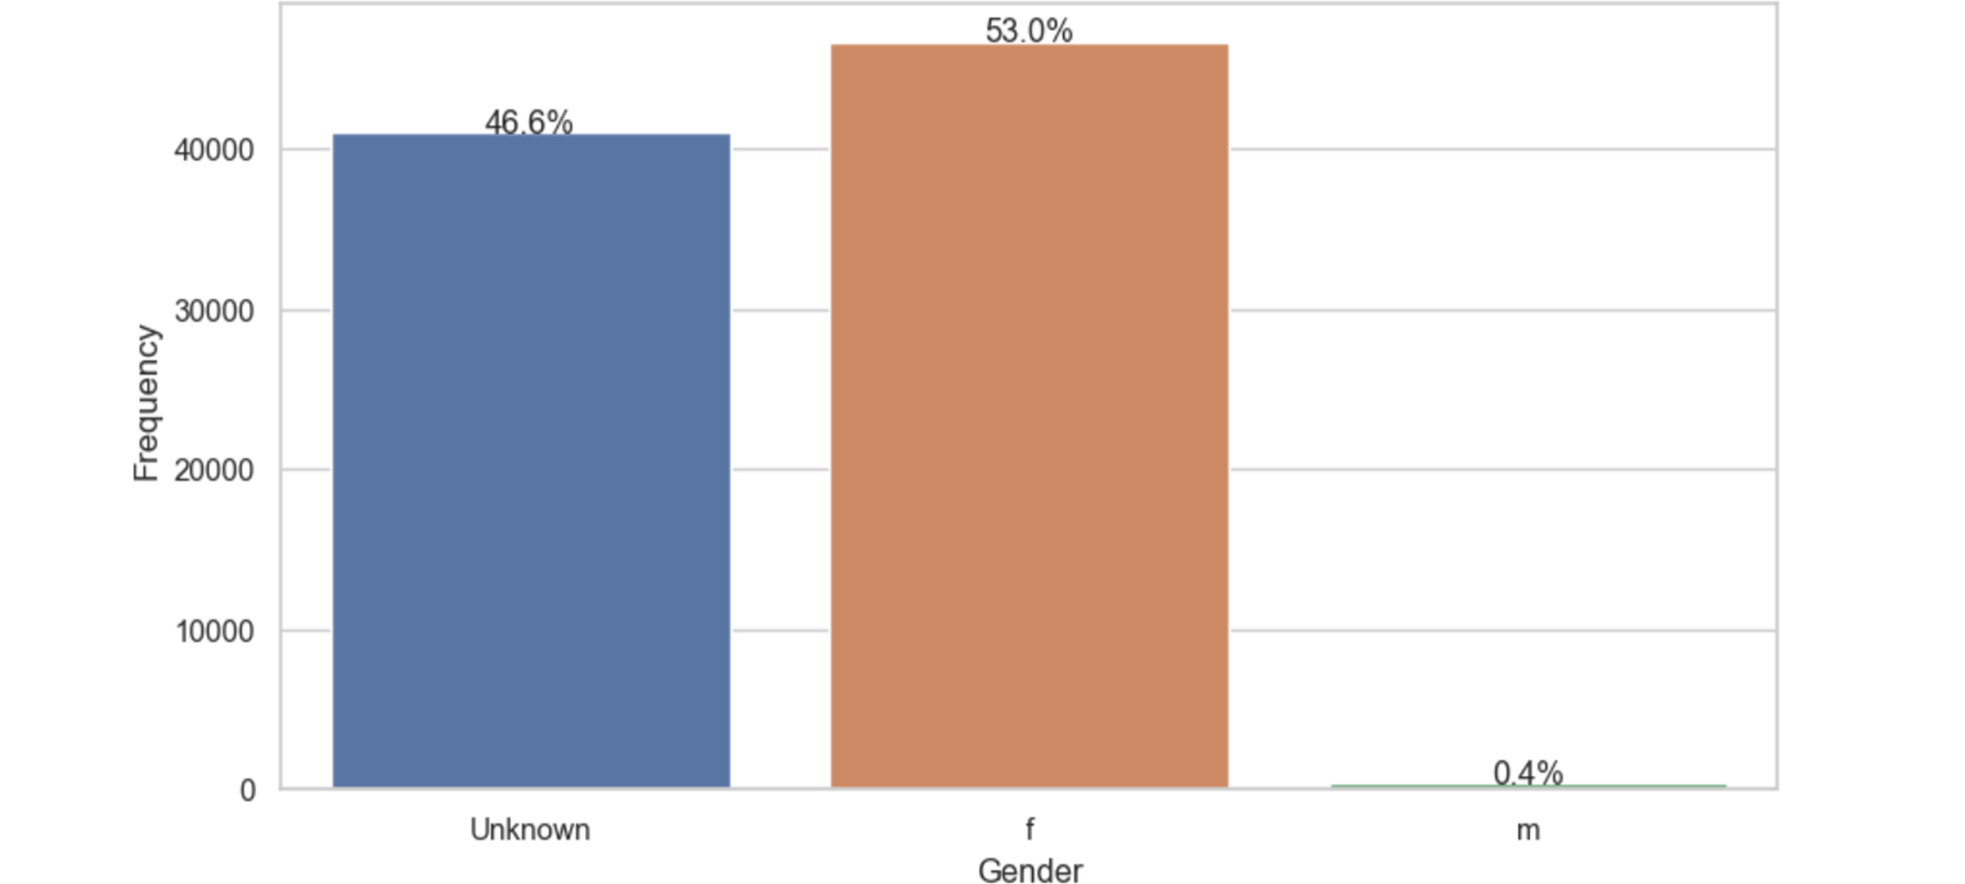
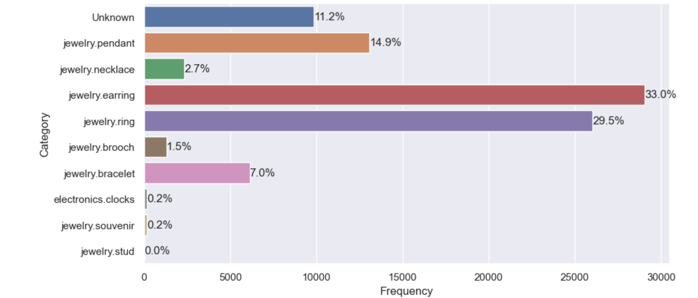
Gender Analysis
Category Analysis
Gender distribution shows 53% female, 46.6% unknown, and 0.4% male, indicating most customers are female.
Earrings and rings are the most popular jewelry types followed by pendants, with other categories showing much lower sales.

Slide 9
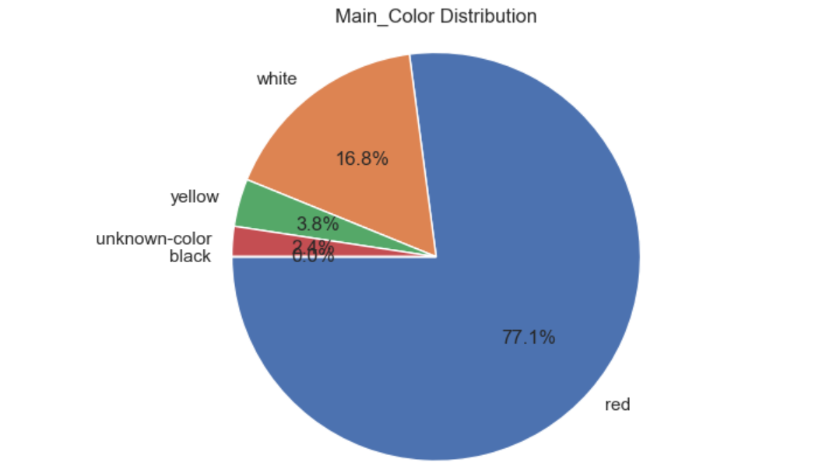
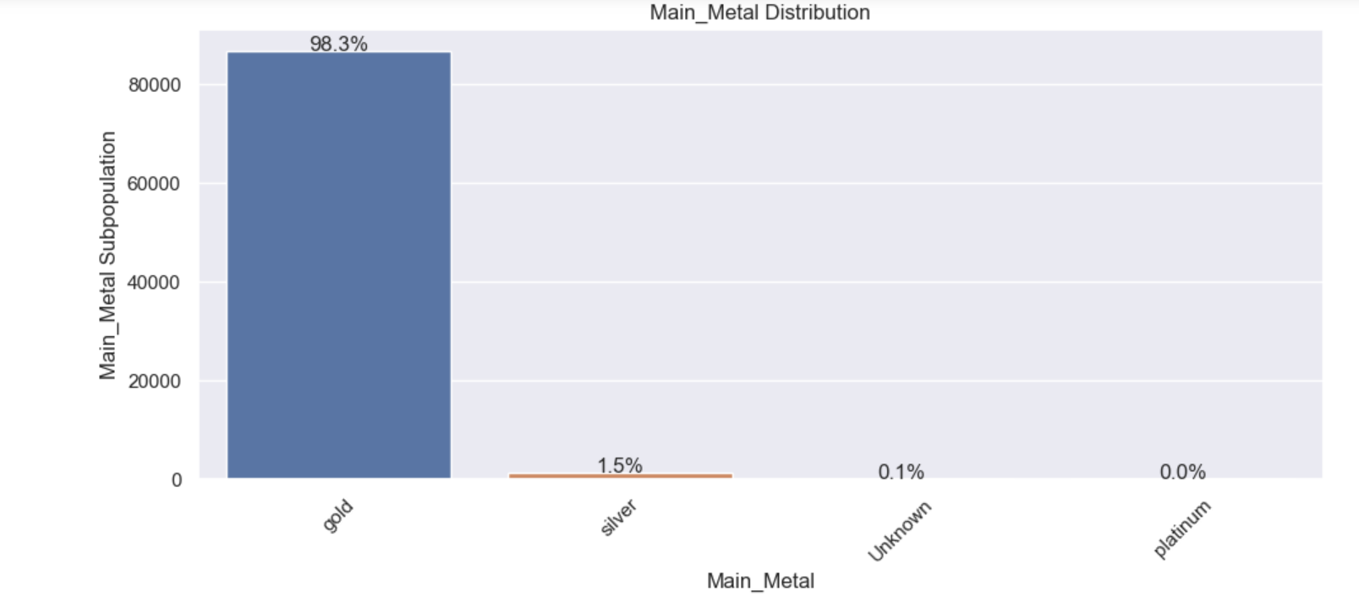
Main Color Analysis
Main Metal Analysis
Red clearly dominates the product lineup, signaling strong customer preference. White trails behind, while yellow is rare. A few unknown color entries may hint at data quality issues worth addressing.
The chart shows that gold overwhelmingly dominates as the main metal used in the products, with silver making up a very small portion. Platinum is virtually absent. This suggests a strong focus on gold-based jewelry, which could reflect customer preference, brand identity, or pricing strategy.

Slide 10
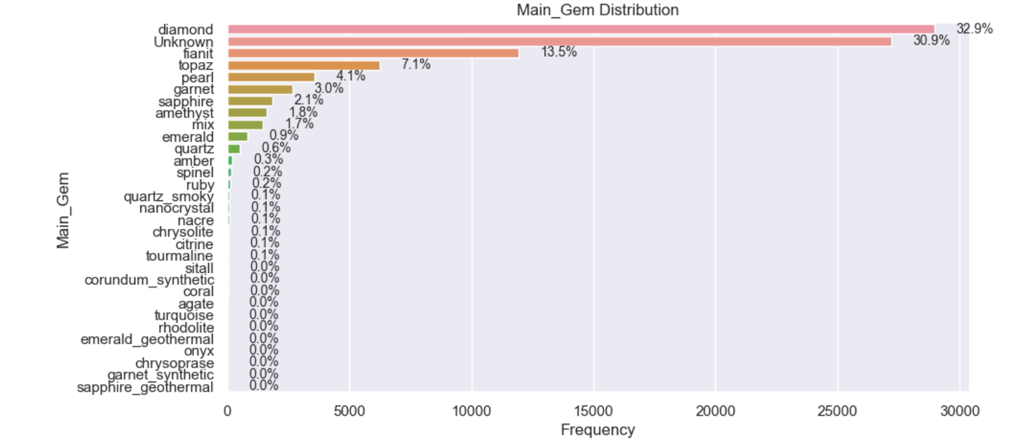
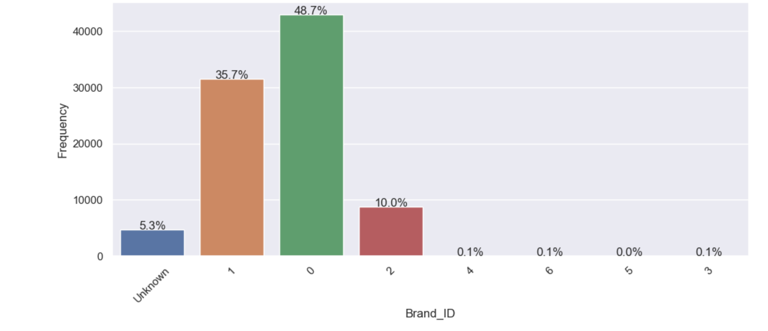
Main Gem Analysis
Brand ID Analysis
The main gem distribution shows that diamonds are by far the most common gemstone used, followed by the unknown gems, fianit and topaz. Pearls, garnets, sapphires and amethysts also appear but in much smaller amounts.
The majority of products come from Brand 0 and Brand 1, with Brand 2 trailing behind. Other brands have barely any presence, and a small portion of items have no brand information at all.

Slide 11
COMPARATIVE ANALYSIS

Slide 12
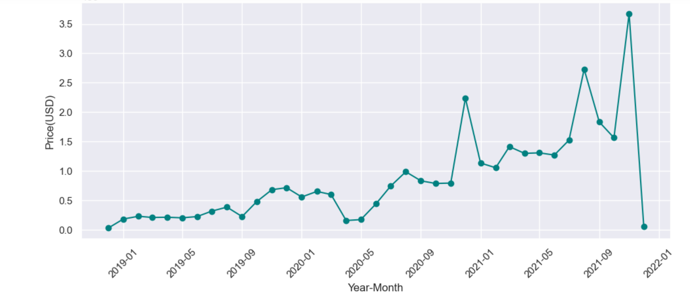
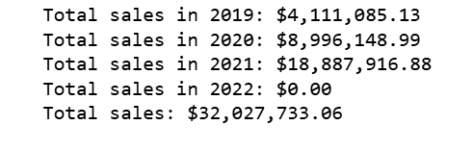
Sales Trend over Time
The sales trend shows steady growth from 2019 through 2020, with a sharp rise in 2021 marked by several spikes. This suggests increasing demand or successful campaigns during that year. However, sales drop off sharply at the end, possibly due to no records for 2022.

Slide 13
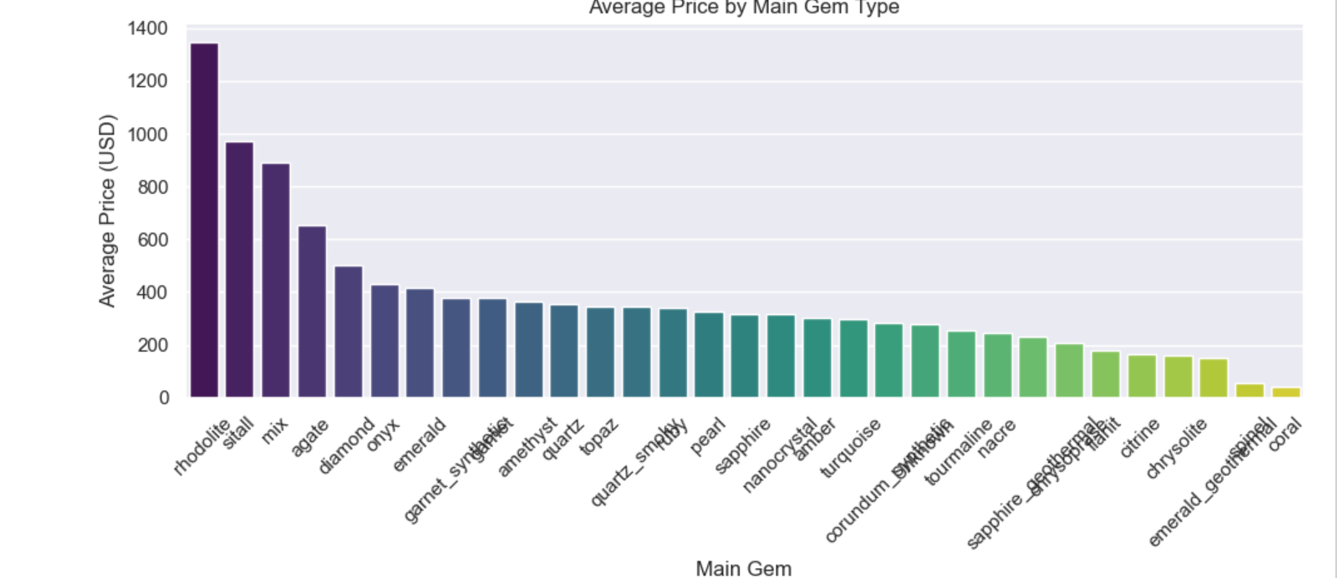
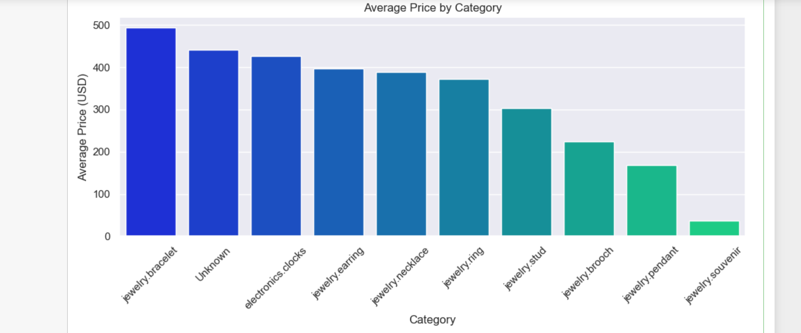
Average Price by Main-Gem
Average Price by Category
Rhodolite and sitall have the highest average prices, while coral, shell, and emerald are the lowest. Diamond and sapphire sit in the mid-to-high range.
Bracelets have the highest average price, showing they’re positioned as premium items. Souvenirs and pendants are cheaper and less popular, pointing to budget-friendly options for casual buyers.

Slide 14
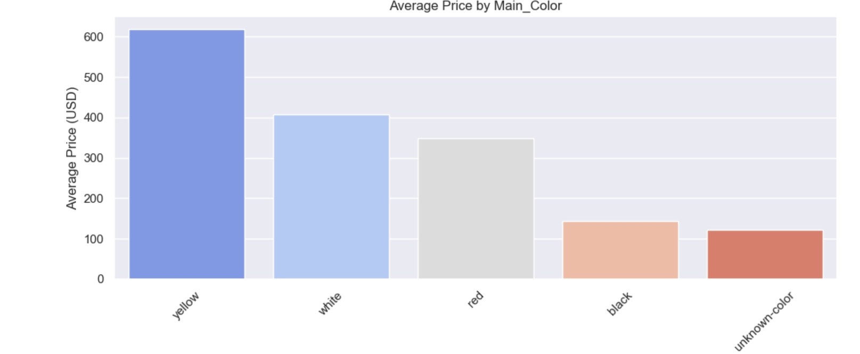
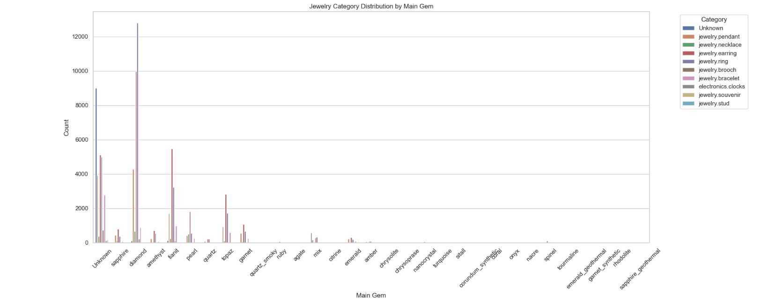
Average Price by Main-Color
Category by Main Gem
Yellow pieces tend to be the most expensive, while white and unknown colors fall in the middle. Red items, though the most common are priced lower. This shows that rarity matters more for price than popularity.
Diamonds are the most common main gem used in jewelry, with earrings and rings being particularly dominant in this category. Fanit and topaz follow, appearing across various jewelry types with earrings dominating. These trends highlight the strong preference for diamonds in high-value jewelry, while other gems serve niche markets.

Slide 15
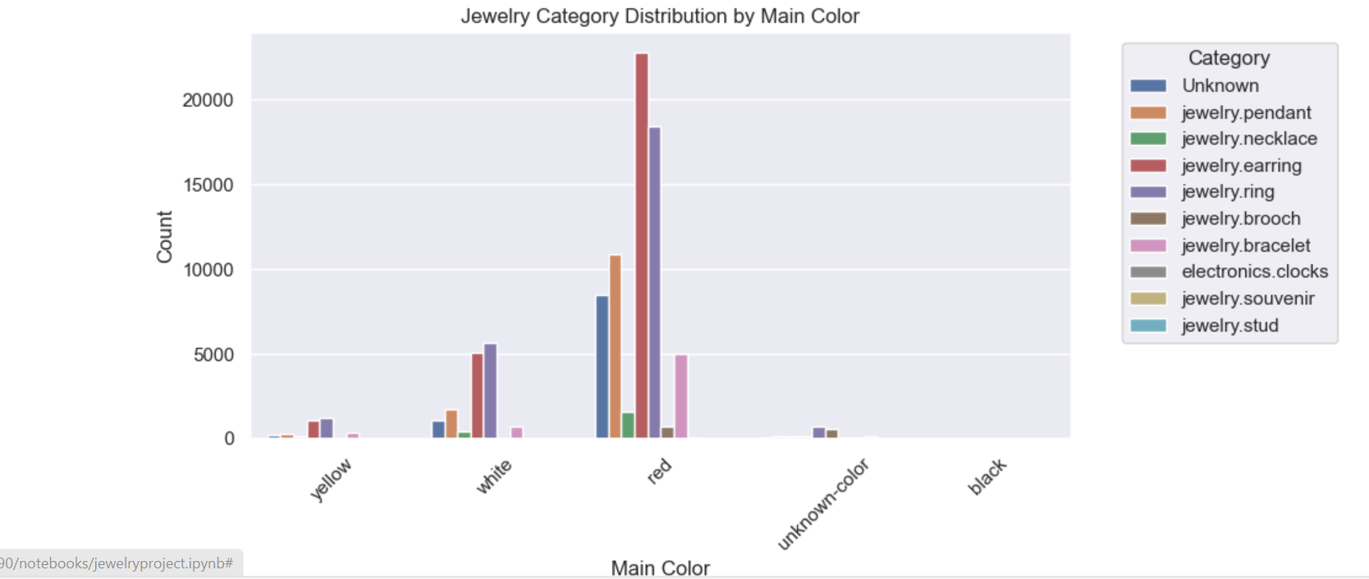
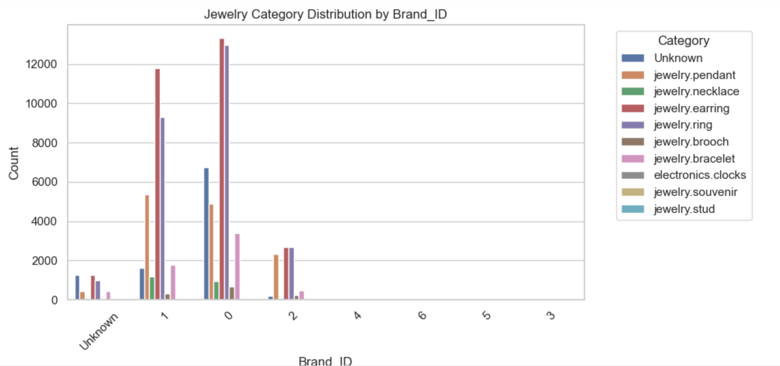
Category by Main-Color
Category by Brand-ID
The red and white jewelry dominate the market, with earrings and rings being the most common in both colors. Yellow jewelry is less frequent and this suggests that earrings and rings are consistently popular across multiple colors, whereas bracelets tend to be more color-specific.
Brands 0 and 1 dominate the jewelry space, especially in earrings and rings.

Slide 16
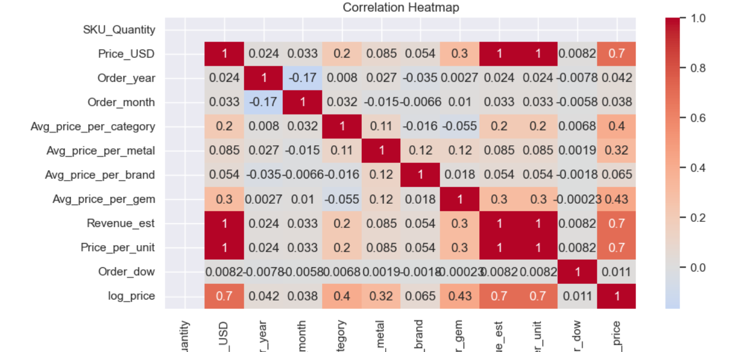
Feature Engineering and Correlation Map
After adding extra features to optimize model performance, the correlation between features and log_price is positive but quite low. The highest is the average price per gem, at just 0.43

Slide 17
MODELING AND EVALUATION

Slide 18
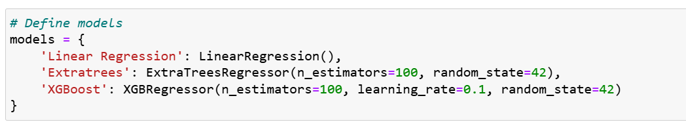
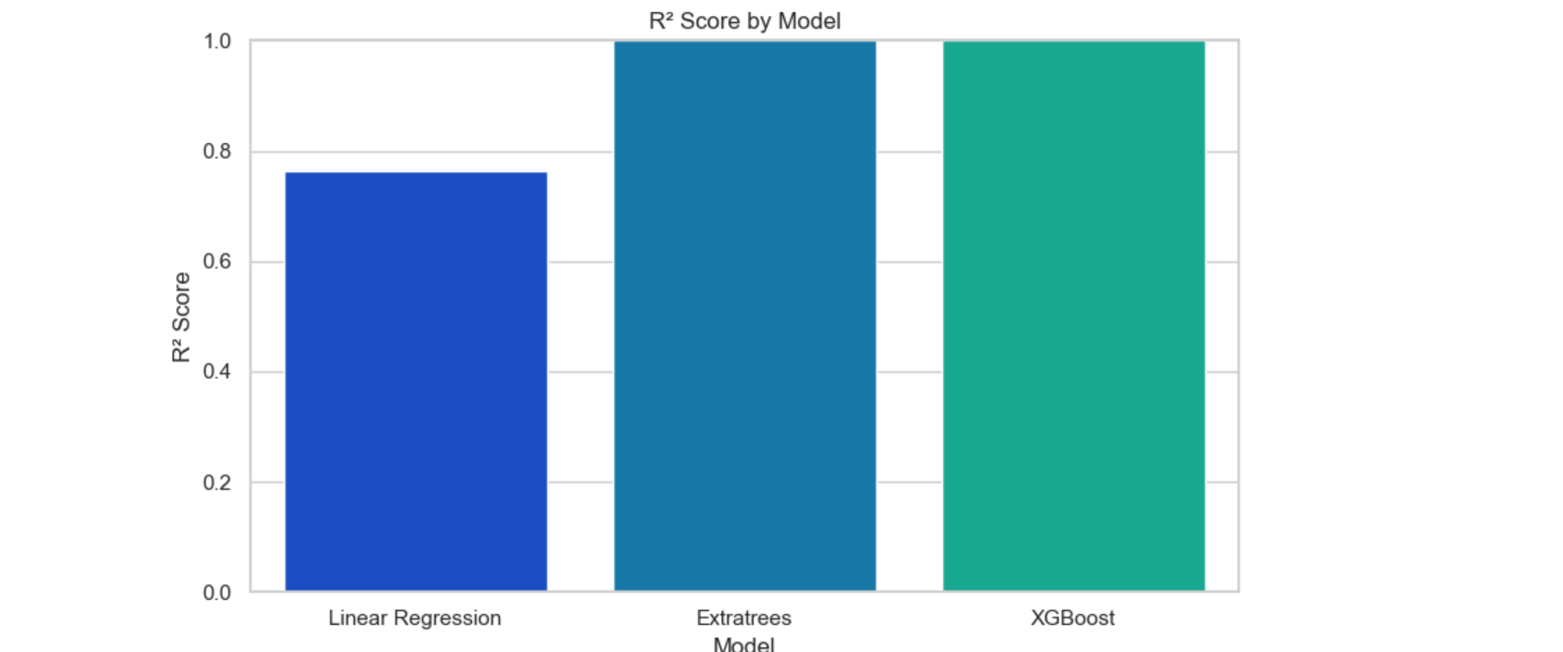
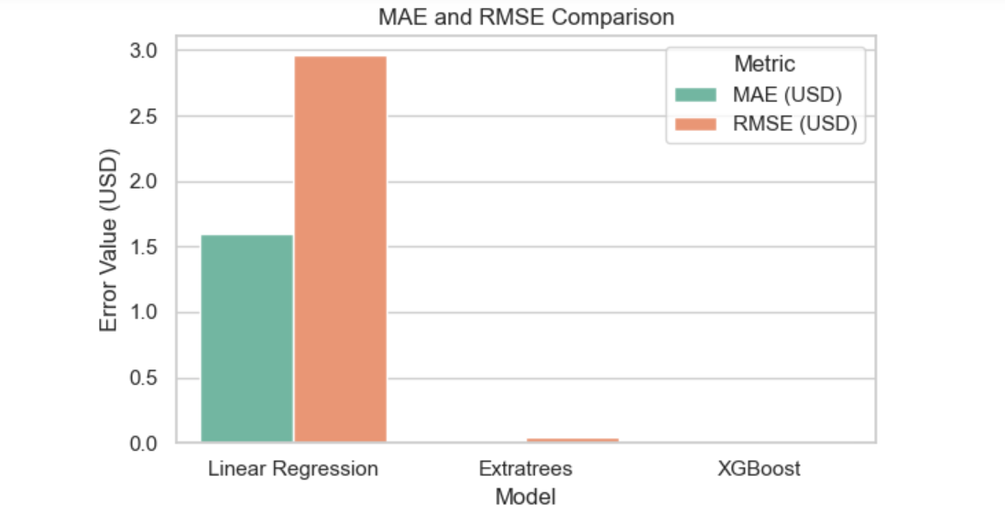
After training the models, Linear Regression achieved an R² of 0.766, while ExtraTrees and XGBoost both scored a perfect 1.0. Despite the higher scores, Linear Regression is likely the most reliable model, as the others appear to have overfitted the training data.

Slide 19


Key Findings
1. Customer data quality is a concern with multiple null entries and over 2,000 duplicate rows, limiting personalization and decision-making accuracy.
2. Most products are affordably priced, but a few expensive outliers are pulling the average up.
3. Popular categories like earrings and rings account for most sales, indicating potential to expand or promote less prominent segments
4. There's a clear gender gap in customer engagement, with men being noticeably less represented in current jewelry sales and interactions.
5. Steady sales growth from 2019 to 2021, with sharp spikes in 2021, suggests rising demand and/or successful marketing campaigns.
6. Gold and diamonds dominate as the main metal and gem, showing strong customer preference for classic, high-value materials that align with a luxury branding strategy,.
7. Red is the most common product color especially in earrings and rings, but yellow-colored items are priced higher, indicating that rarity, not frequency, drives perceived value.

Slide 20
Enhance data quality through improved collection methods and validation processes.
RECOMMENDATIONS
Enhance data quality by implementing advanced collection techniques and rigorous validation processes.
2. Review the pricing strategy to ensure high-priced items are delivering value, and explore ways to better align pricing with different customer segments.
3. Drive sales by promoting best-selling categories, premium materials, and gemstones through targeted ads and dedicated campaigns. boost weaker products using bundles and seasonal deals—without overdoing it—to raise visibility.
4. Features show low correlation with price, prioritize gathering detailed customer demographics such as age and location. This data will enable more effective, personalized marketing strategies.
5. Leverage seasonal sales trends by analyzing the 2021 sales spikes to forecast demand and strategically plan campaigns during peak periods, maximizing impact and revenue.
6. Develop jewelry collections that appeal to men to help balance gender segmentation and expand market reach.

Slide 21

THANK YOU

